Slide 1
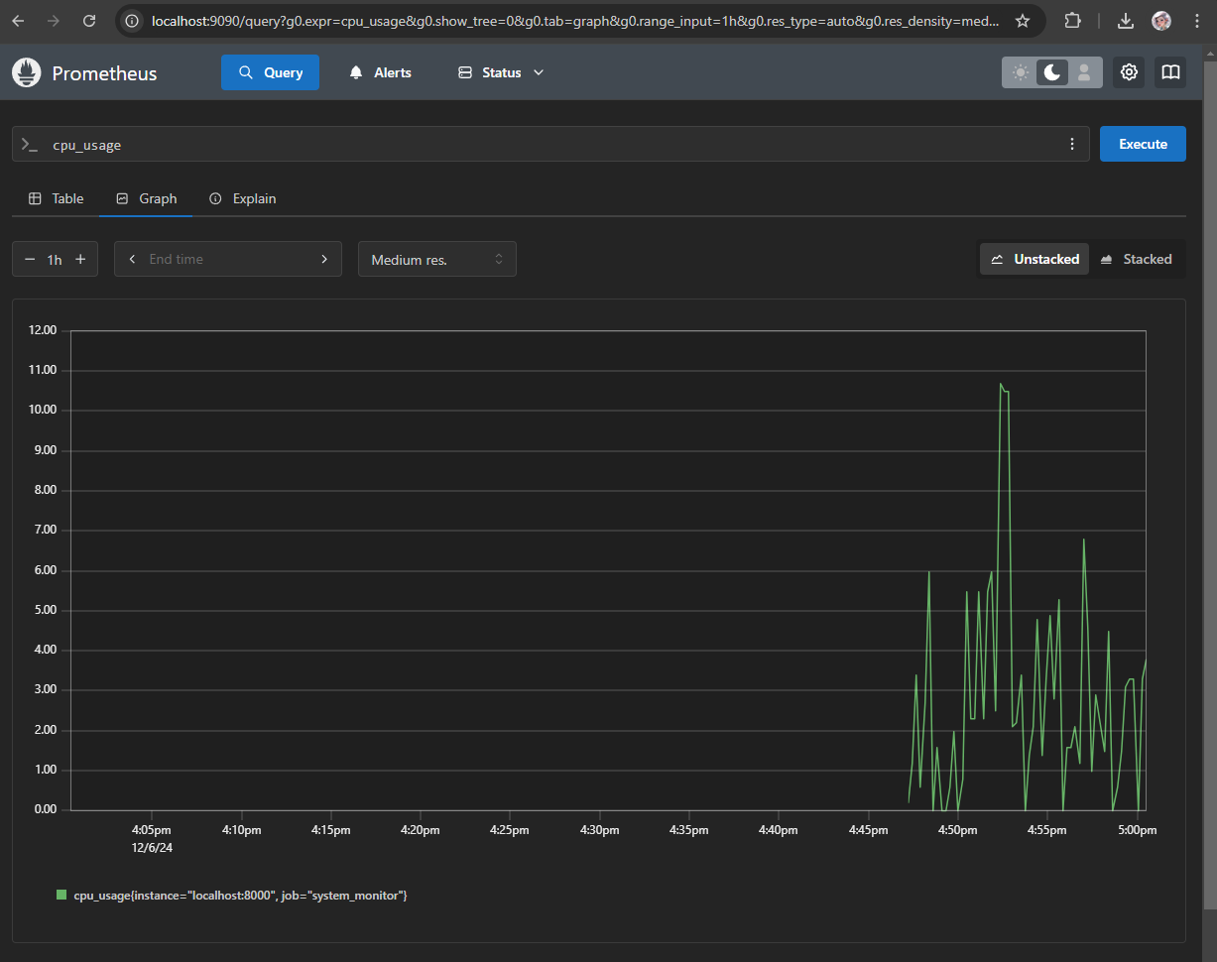
System Monitoring Project with Python, Prometheus, and Grafana
Real-Time System Monitoring and Visualization
Jyotshna Trivedi
jyotshna88088@gmail.com
GitHub: github.com/dev-jyotshna

Slide 2
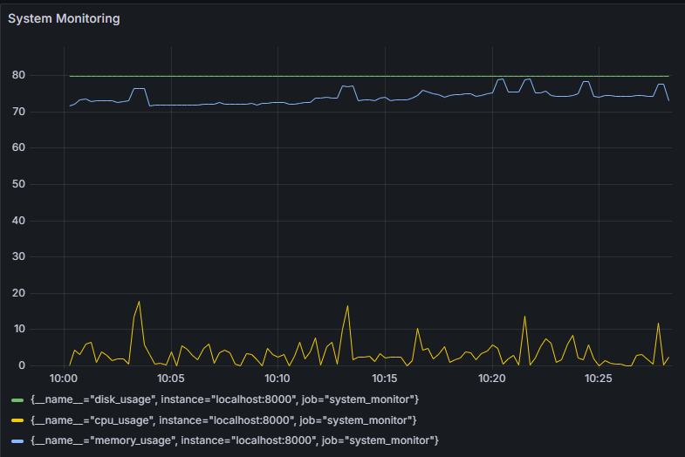
Why Monitoring Matters
Systems need constant monitoring for optimal performance and reliability
Commercial monitoring tools can be expensive and inflexible
A free, open-source alternative is desirable for smaller organizations and personal projects
Visual : Grafana dashboard

Slide 3
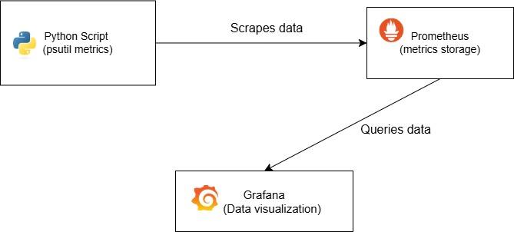
Project Goals
Collect system metrics like CPU, memory, and disk usage in real time
Store and query metrics efficiently using Prometheus
Visualize data with Grafana dashboards
Keep the project cost-free and lightweight

Slide 4
System Architecture
Python Script
Prometheus
Grafana
Python Script:
Collects system metrics using the psutil library and exposes them via an HTTP endpoint.
This is the initial step in the system architecture where data is gathered.
Database:
Scrapes the metrics from the Python script and stores them in its time-series database.
Visualization:
Queries Prometheus and visualizes the metrics on interactive dashboards.

Slide 5



Technology Stack
Python & psutil: Collect metrics like CPU, memory, and disk usage
Prometheus: Store and query metrics efficiently
Grafana: Build customizable dashboards

Slide 6
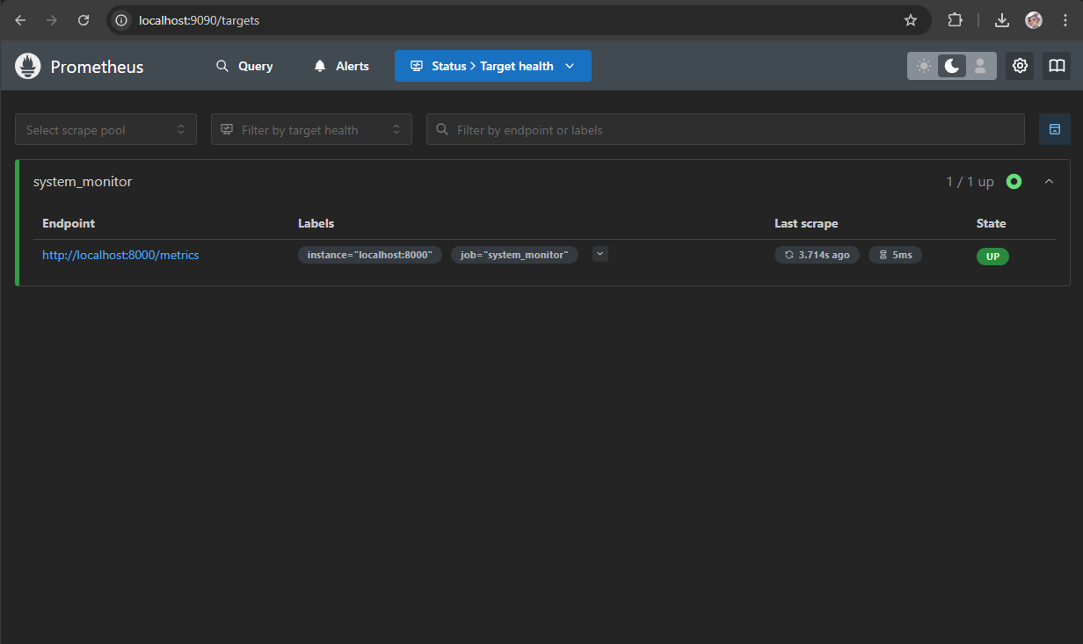
How It Works
The Python script collects system metrics using psutil
The script exposes these metrics to Prometheus via an HTTP endpoint
Prometheus scrapes and stores the metrics
Grafana queries Prometheus and displays the data visually

Slide 7
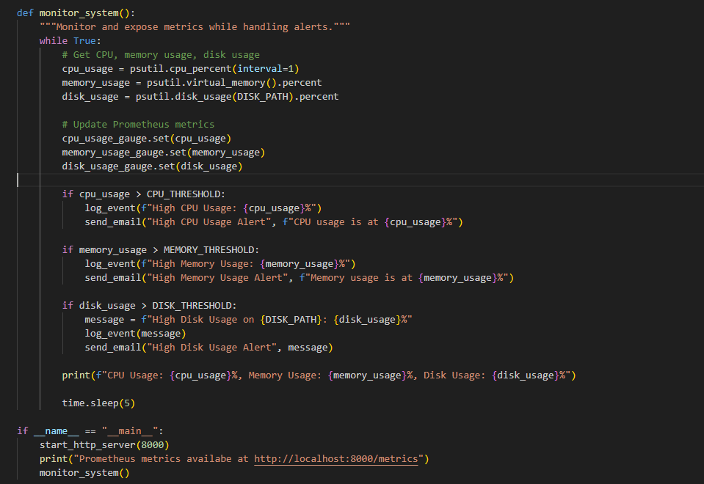
Project in Action
Run the Python script to expose metrics
Start Prometheus and verify the target
Open Grafana and view the live dashboard

Slide 8
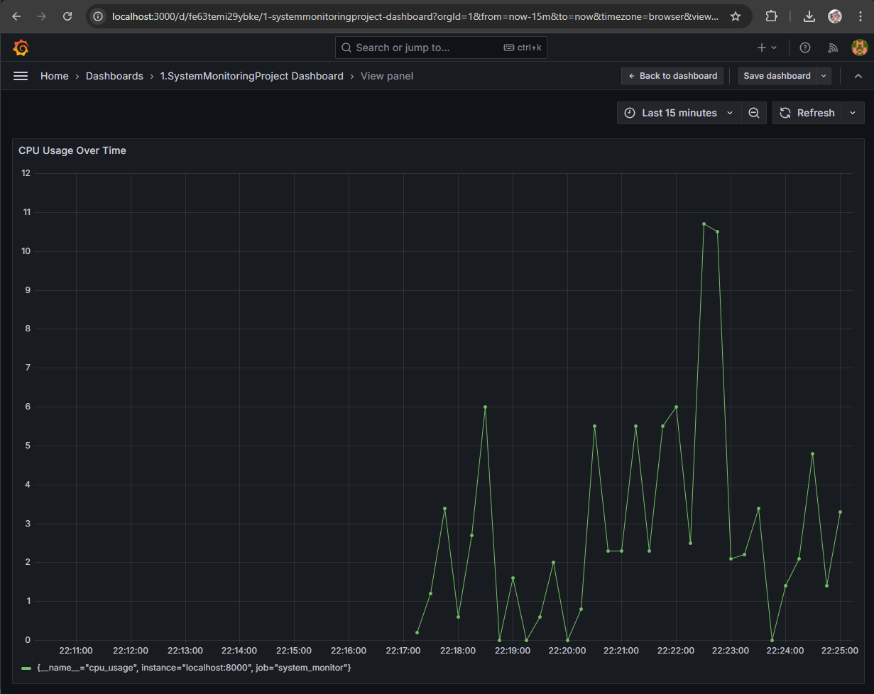
Key Features
Real-time system monitoring for CPU, memory, and disk usage
Easy-to-extend architecture for adding new metrics
User-friendly Grafana dashboards
Completely free and open-source

Slide 9
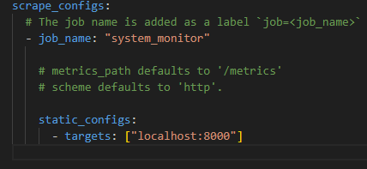
Overcoming Challenges
Configuring Prometheus to scrape data at proper intervals
→ Resolved by editing the prometheus.yml file
Designing clear Grafana dashboards
→ Iteratively tested with sample data
Managing sensitive credentials
→ Used .env files and .gitignore

Slide 10
Enhancements and Scalability
Future Scope
Add more metrics (e.g., network bandwidth, GPU usage)
Deploy the system on the cloud (AWS/ GCP/ Azure)
Implement alerting and notifications for multiple and critical thresholds
Optimize the Python script for distributed environments

Slide 11

THANK YOU
Additional Resources
GitHub Repository: github.com/dev-jyotshna/system-monitoring-project
Prometheus Documentation: Prometheus
Grafana Documentation: Grafana
psutil Documentation: psutil
GitHub repo QR Code
Notes:
This project provides a powerful, free, and customizable solution for project provides a powerful, free, and customizable solution for real-time system monitoring. It demonstrates the power of combining Python with Prometheus and Grafana. Thank you! Any questions?

